Slide 1


Master thesis: Recognizing Urban Points of Interests with Convolutional Neural Networks
1st presentation
Andriy Zoryk

Slide 2
Agenda
Motivation
What is CNN?
Related works
Datasets
References

Slide 3
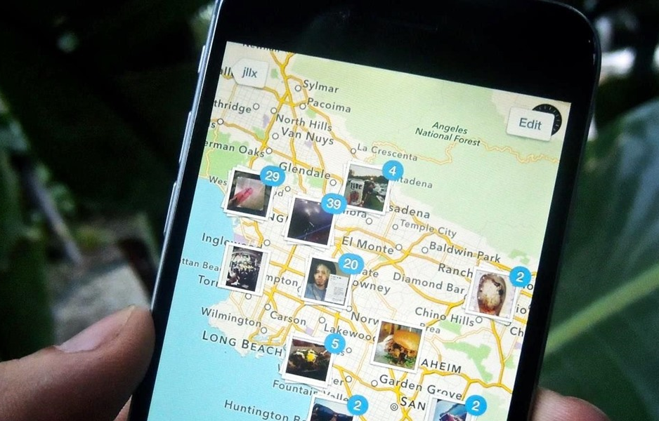
Motivation
In smartphones, additional information is automatically captured, such as longitude and latitude of where the image was taken
[source: ios.gadgethacks.com]

Slide 4
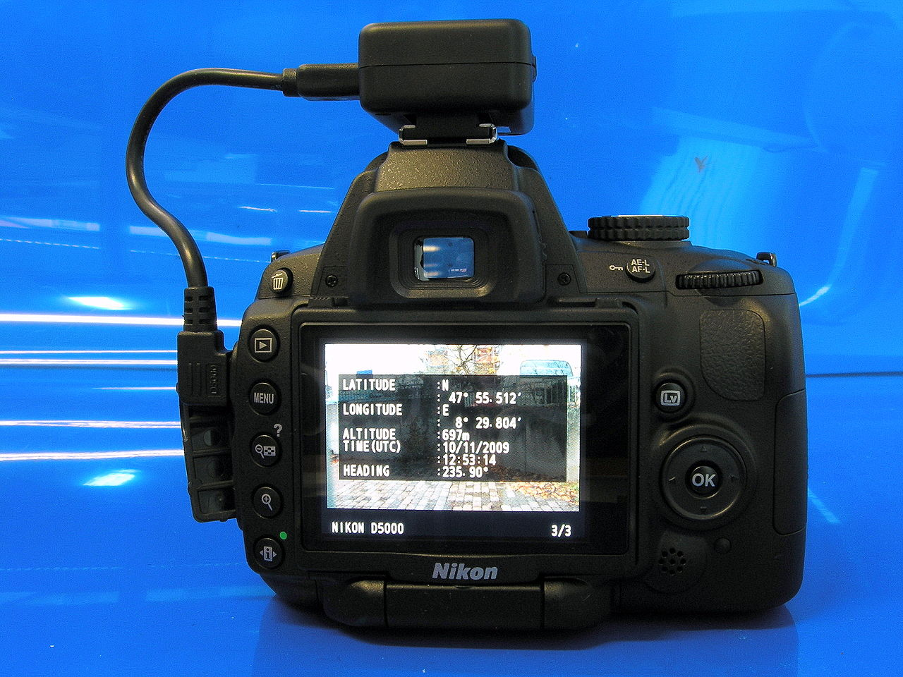
Motivation
Several manufacturers offer cameras with a built-in GPS receiver
Some digital cameras and camera phones support an external GPS receiver connected by cable, or inserted into the memory card slot or flash shoe.
[source: commons.wikimedia.org]

Slide 5
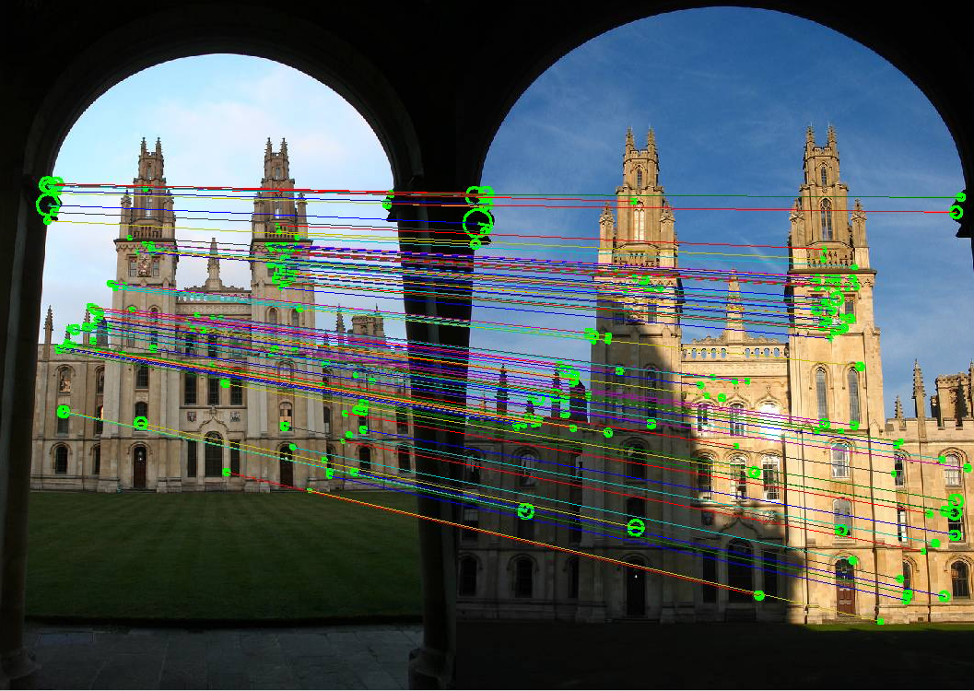
Recognizing Urban Points of Interests with Convolutional Neural Networks
Motivation
[source: robots.ox.ac.uk]

Slide 6

What is CNN?
Convolutional neural networks or CNNs (LeCun, 1989), are a specialized kind of neural network for processing data that has a known, grid-like topology. [Goodfellow, Bengio, Courville. Deep Learning, 2016]
The name “convolutional neural network” indicates that the network employs a mathematical operation called convolution
[image source: graphics.cs.cmu.edu]

Slide 7
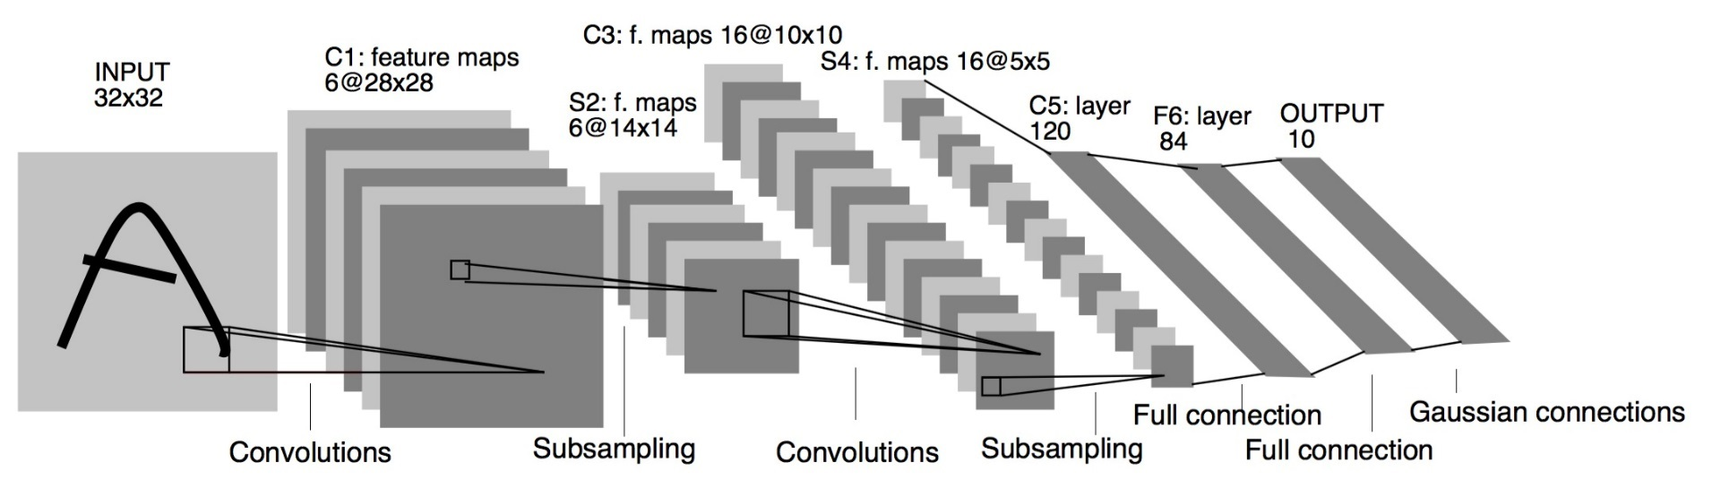
LeNet5 (LeCun, Bottou, Bengio,Haffner, 1994)
What is CNN?
It is the year 1994, and this is one of the very first convolutional neural networks, and what propelled the field of Deep Learning. This pioneering work by Yann LeCun was named LeNet5 after many previous successful iterations since they year 1988!
LeNet: a layered model composed of convolution and subsampling operations followed by a holistic representation and ultimately a classifier for handwritten digits [Yann LeCun; LeNet]
[LeCun et al., 1988]

Slide 8
LeNet (1994)
What is CNN?
LeNet5 features can be summarized as:
convolutional neural network use sequence of 3 layers: convolution, pooling, non-linearity (key feature)
use convolution to extract spatial features
subsample using spatial average of maps
non-linearity in the form of tanh or sigmoids
multi-layer neural network (MLP) as final classifier
sparse connection matrix between layers to avoid large computational cost
In overall this network was the origin of much of the recent architectures, and a true inspiration for many people in the field.

Slide 9
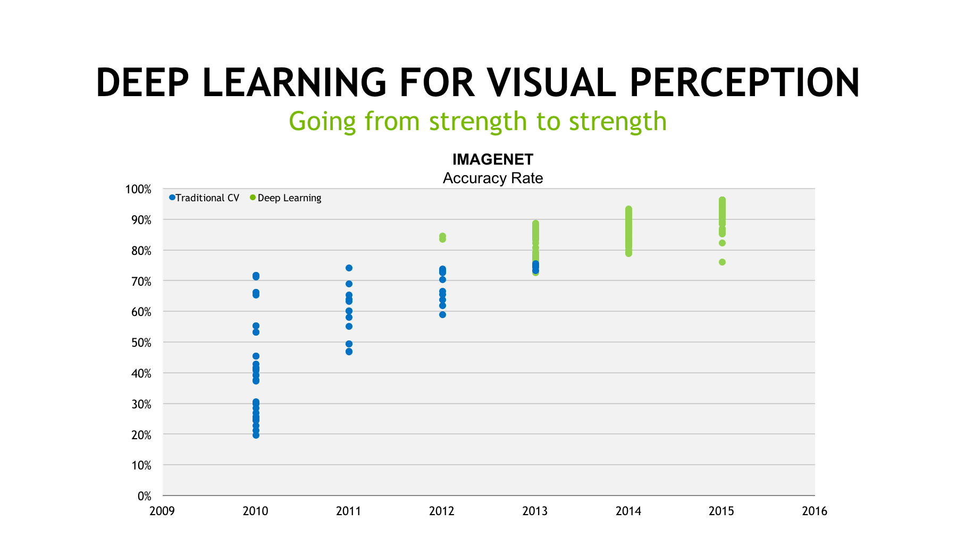
What is CNN?
[source: https://blogs.nvidia.com]

Slide 10
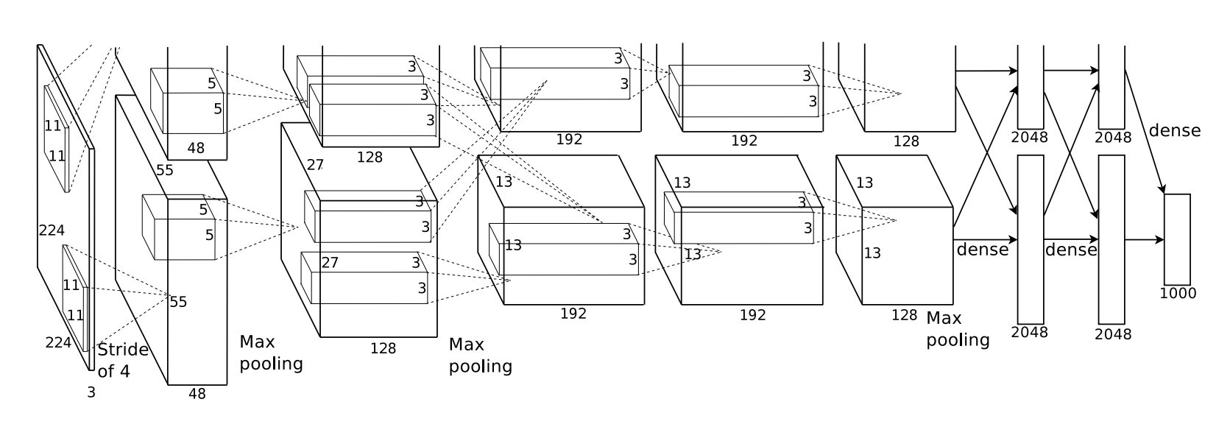
AlexNet (Krizhevsky, Sutskever, Hinton 2012) ImageNet Classification with Deep CNN
What is CNN?
Bigger model as LeNet (7 hidden layers, 650,000 units, 60 Mio parameters)
More data (10**6 vs. 10**3 images)
GPU implementation (50x speedup over CPU). Trained on two GPU for a week.
[Krizhevsky et al., 2012]

Slide 11
VGG-16, VGG-19
What is CNN?
much smaller 3×3 filters in each convolutional layers and also combined them as a sequence of convolutions.
This seems to be contrary to the principles of LeNet, where large convolutions were used to capture similar features in an image. Instead of the 9×9 or 11×11 filters of AlexNet, filters started to become smaller, too dangerously close to the infamous 1×1 convolutions that LeNet wanted to avoid, at least on the first layers of the network.

Slide 12
Im2GPS (Hays and Efros, 2008) estimating geographic information from a single image
Related works
one of the first approaches to geolocate random pictures
Dataset - over 6 million GPS-tagged images from the Internet
[Hays, Efros, 2008]

Slide 13
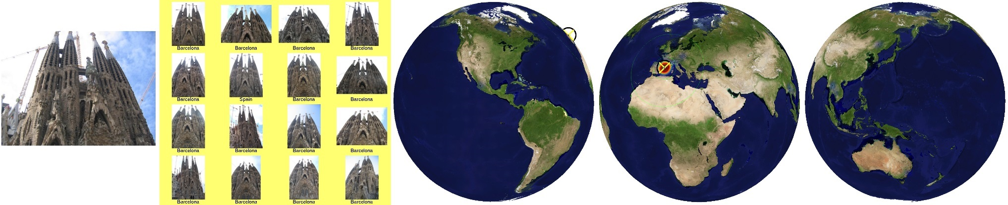
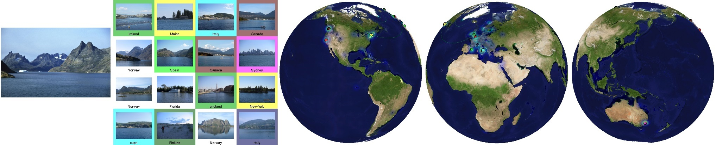
IM2GPS visualization
Related works
Each result shows the query image, a montage of the top 16 nearest neighbors from the database, and three views of the Earth
[source: http://graphics.cs.cmu.edu/projects/im2gps/results.html]

Slide 14
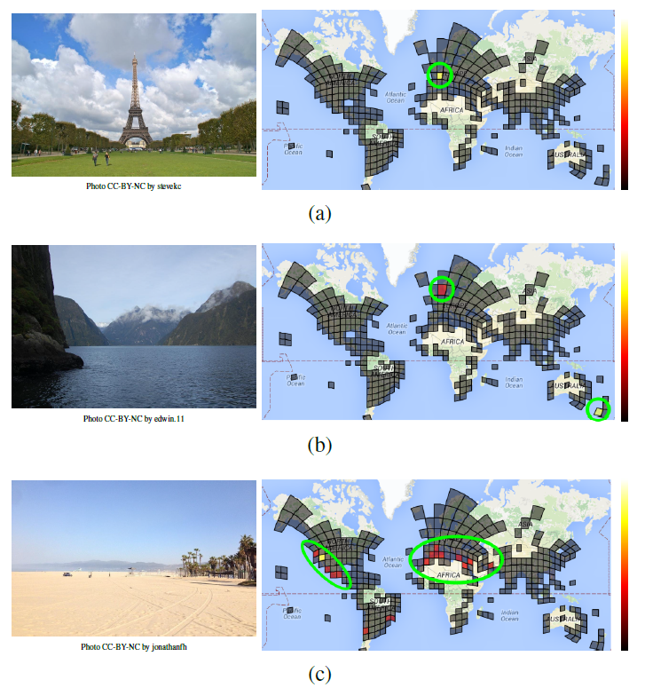
PlaNet (Weyand, Kostrikov, Philbin, 2016) Photo Geolocation with Convolutional Neural Networks
Related works
main goal – localize any type of photo taken in any location,
classification problem,
the partitioning of the earth’s surface into set of non-overlapping cells,
dataset of 126M photos with Exif geolocations mined from all over the web,
using deep network and an LSTM architecture.
[Weyand, Kostrikov, Philbin, 2016]

Slide 15
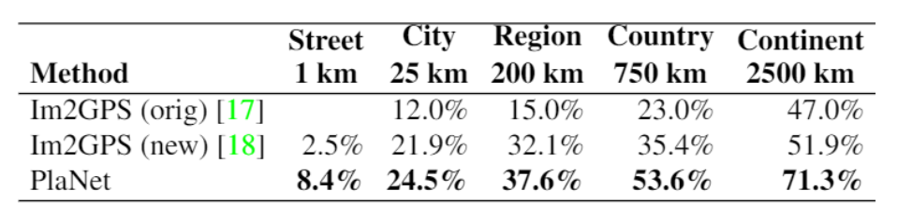
PlaNet (Weyand, Kostrikov, Philbin, 2016) Photo Geolocation with Convolutional Neural Networks
Related works
Comparison of PlaNet with Im2GPS. Percentages are the fraction of images from the Im2GPS test set that were localized within the given radius.
[source: Weyand, Kostrikov, Philbin, 2016]

Slide 16
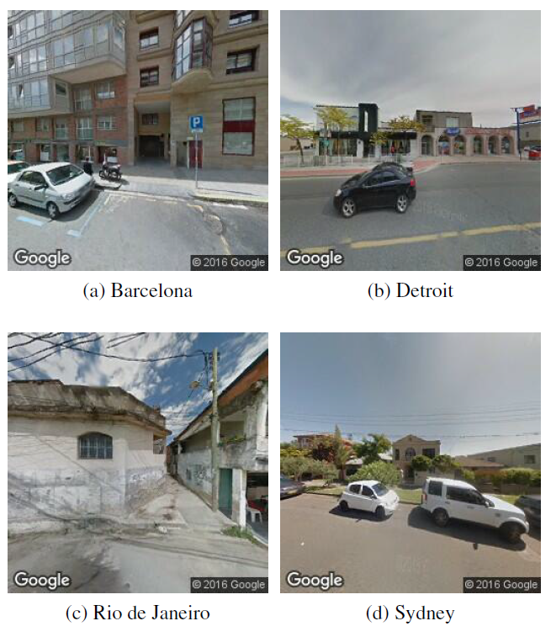
Little PlaNet (Hershey, Wulfe, 2016) Recognizing Cities from Street View Images
Related works
classification problem
dataset of 100K photos taken from Google Street View in 10 different cities,
was used GoogLeNet model pretrained on the Places205 dataset and the neural network library Caffe
LittlePlaNet achieves superhuman accuracy on this dataset, at a surprisingly high 75%
Randomized Street View Images from Four Cities
[source: Hershey, Wulfe, 2016]

Slide 17
Main tasks
Choose a framework
Use the GPU
Obtain a dataset

Slide 18
Datasets
Flickr Yahoo!
Google StreetView

Slide 19
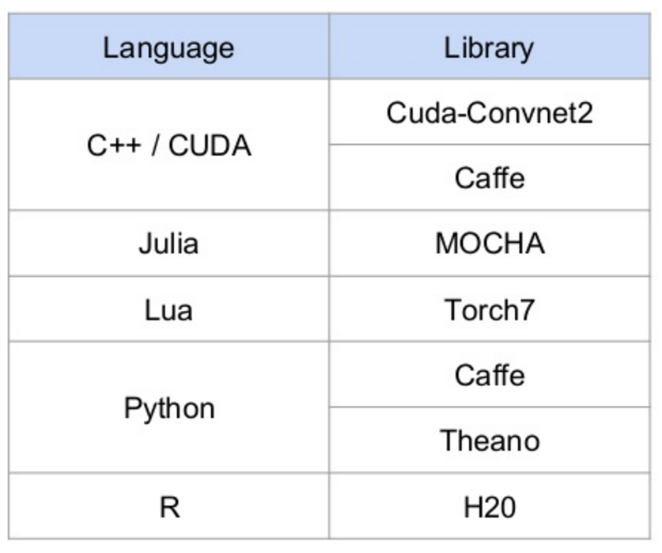
Choose a framework
Datasets
[source: https://www.slideshare.net/didericksen/deep-learning-presentation]

Slide 20
Bamberg City Points of Interest
Bamberger Dom
Altes Rathaus
Kloster Michelsberg
Klein Venedig
Altenburg
Neue Residenz
Alte Hofhaltung

Slide 21
References
Yann LeCun, Leon Bottou, Yoshua Bengio and Patrick Haffner. Gradient-Based Learning Applied to Document Recognition. 1998
J. Hays and A. Efros. IM2GPS: estimating geographic information from a single image. 2008.
Alex Krizhevsky, Ilya Sutskever, Geoffrey E. Hinton. ImageNet Classification with Deep Convolutional Neural Networks. 2012
Tobias Weyand, Ilya Kostrikov, and James Philbin. PlaNet - Photo Geolocation with Convolutional Neural Networks, 2016.
Hershey, D., & Wulfe, B. Recognizing Cities from Street View Images. 2016.

